Slide 1
Assignment- Great Learning
By- Yash Agarwal

Slide 2
Problem Formulation
“Simulate a pandemic-style triage system using modular agents that accept clinical artifacts, suggest OTC treatments, and coordinate mock pharmacy delivery. The system uses dummy classifiers and non-clinical logic to ensure safety, scalability, and educational value.”

Slide 3
Objective
“Build a proof-of-concept multi-agent pipeline that demonstrates safe, modular healthcare automation using simulated inputs and outputs.”

Slide 4
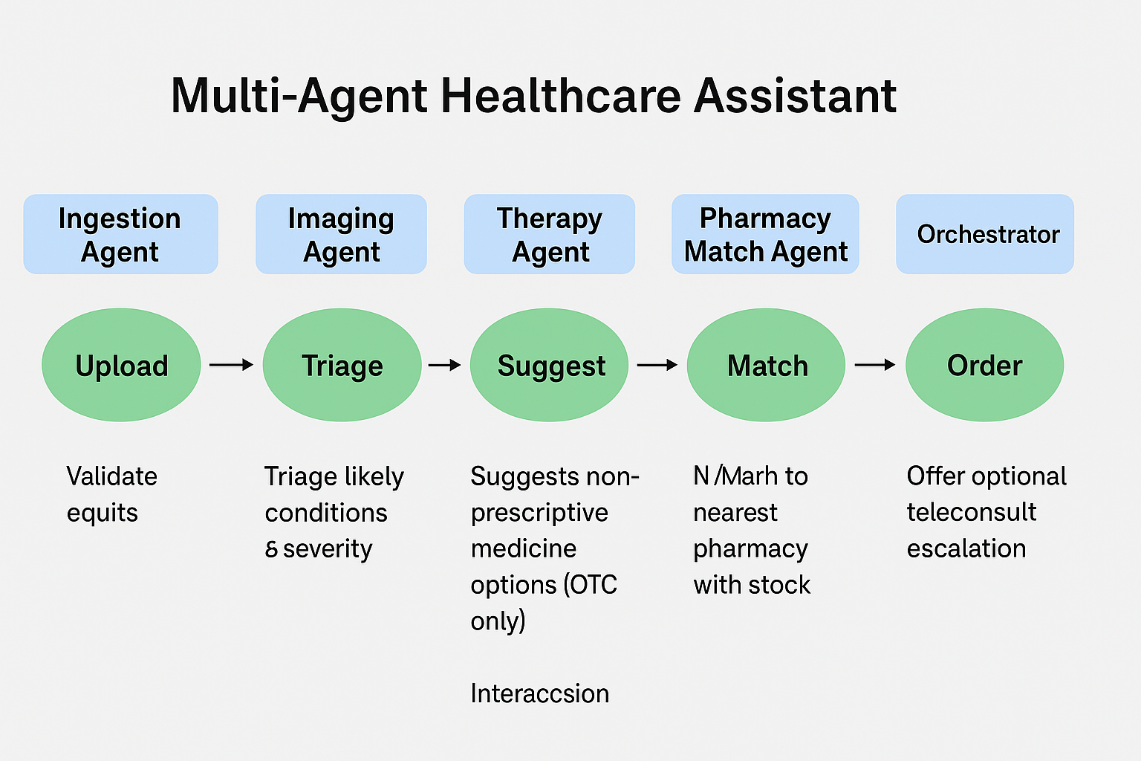

Slide 5
Flow
Input
Ingestion agent
Imaging agent
Coordinator
Pharamcy agent
OTC agent

Slide 6
Limits
No access to real world data.
No emergency route for urgent cases.
No human intervention to learn right or wrong.

Slide 7
Next Steps.
Make a image agent trained on real data.
Make agents intelligent.
Use API to collect data easily.
Add a chatbot to clarify issues.

